Slide 1
From local to national initiatives:
How to make reproducible research the norm
Ulf Toelch | BIH QUEST Center for Responsible Research

Slide 2
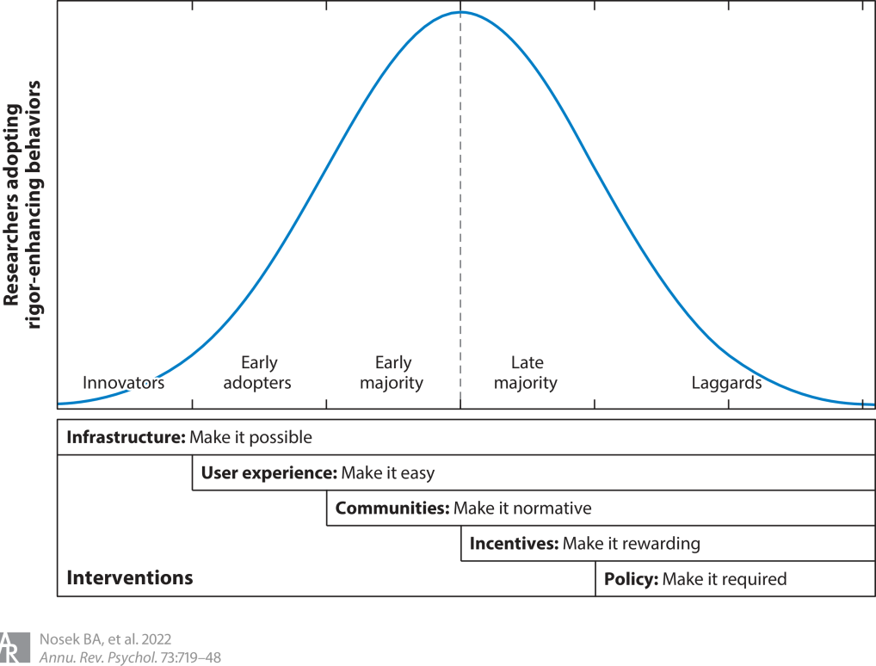
Diffusion of Reproducible Research Practices

Slide 3
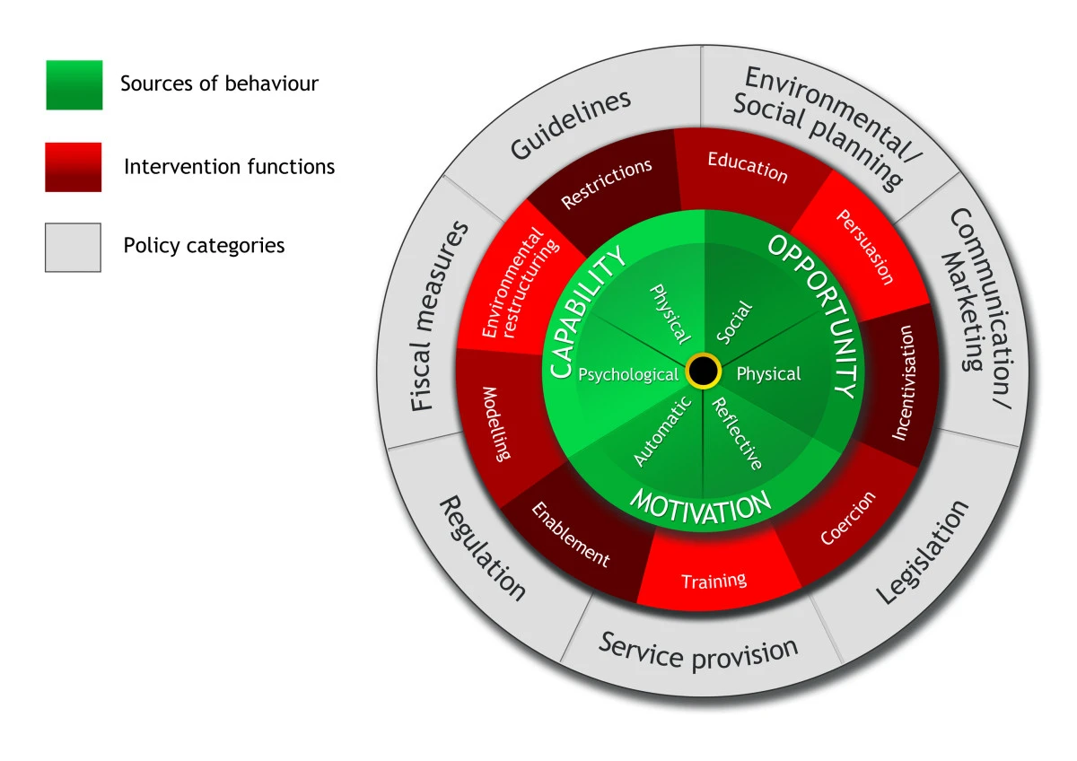
Behavioural change wheel as a model for uptake of repsonsible/reproducible research practices
Michie, S., van Stralen, M.M. & West, R. The behaviour change wheel: A new method for characterising and designing behaviour change interventions. Implementation Sci 6, 42 (2011). https://doi.org/10.1186/1748-5908-6-42

Slide 4
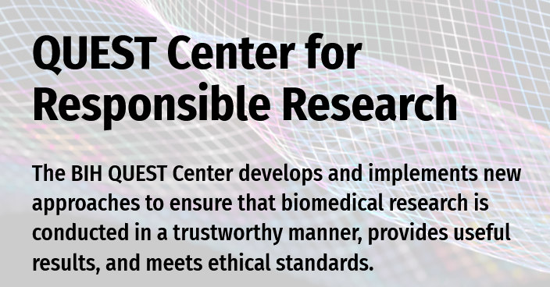
QUEST (est. 2017) - Quality Ethics Open Science Translation
Center for Responsible Research
http://quest.bihealth.org

Slide 5
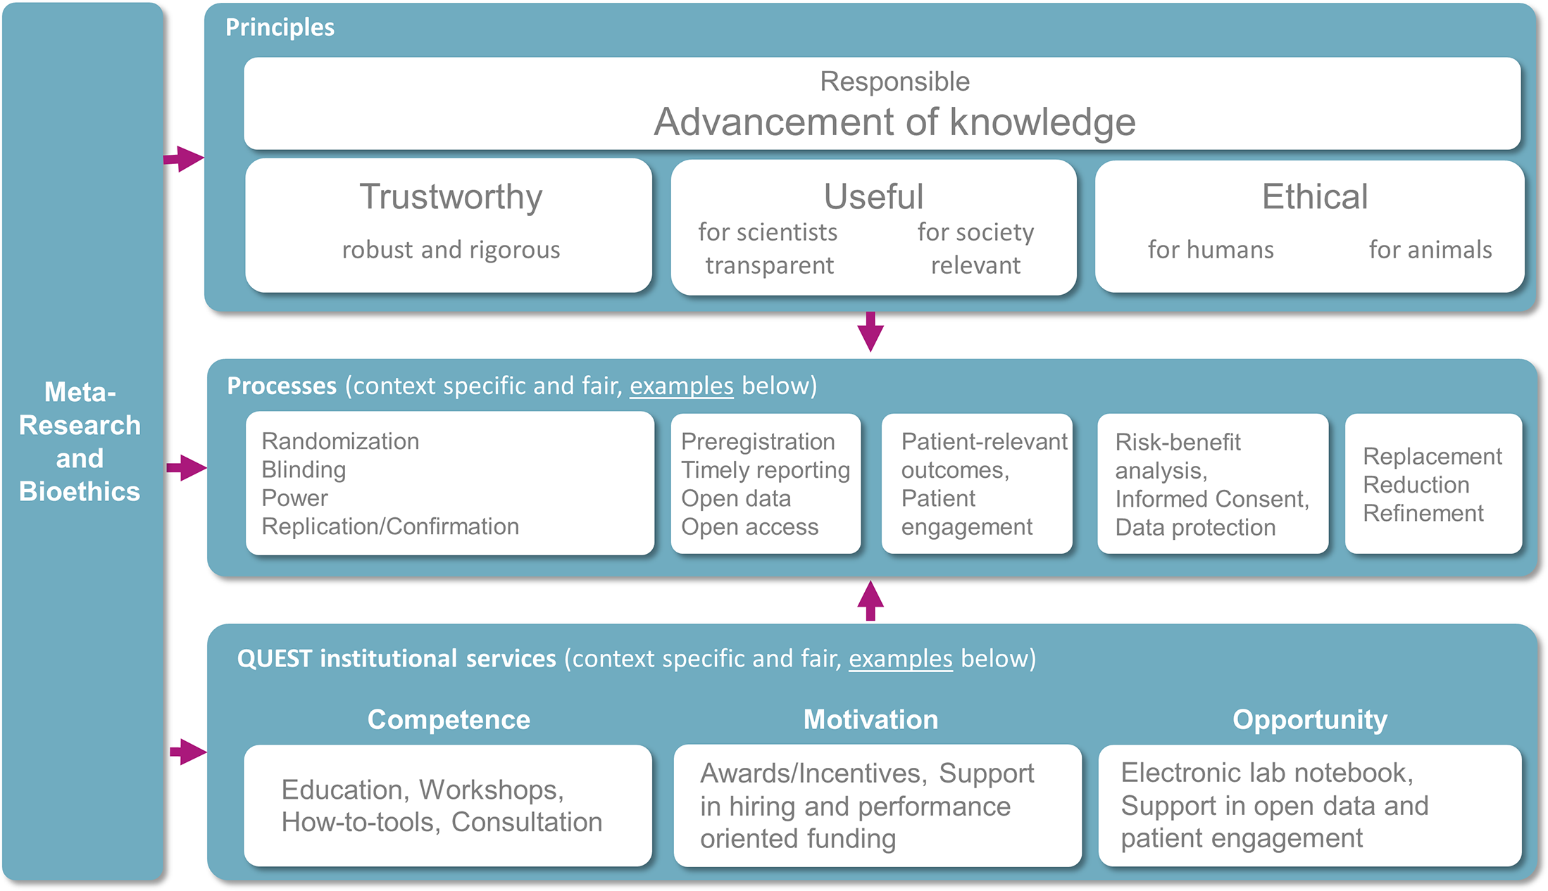
QUEST Framework

Slide 6


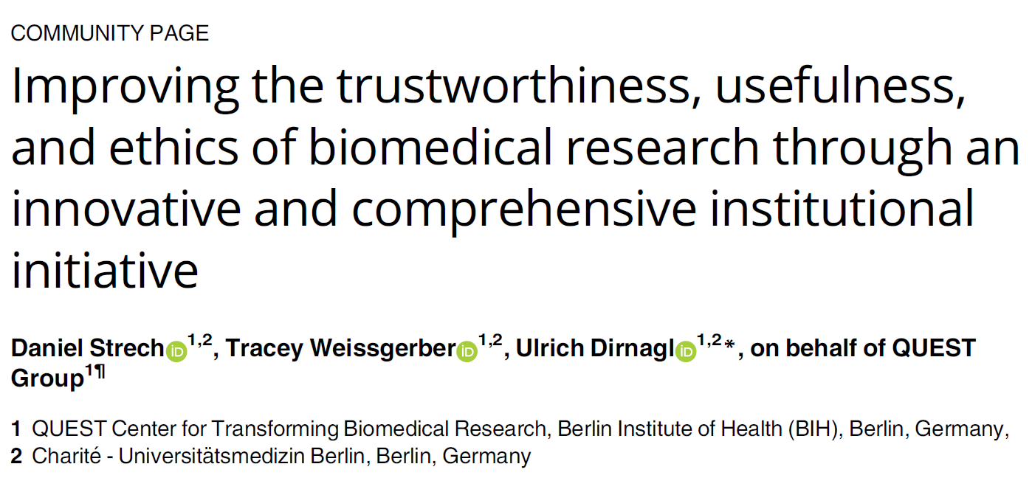
QUEST Framework

Slide 7
Focus topics of QUEST
Education & Training
Quality Assurance
Open Science
Patient & Stakeholder Engagement
Meta Research
Incentives & Reward Systems

Slide 8
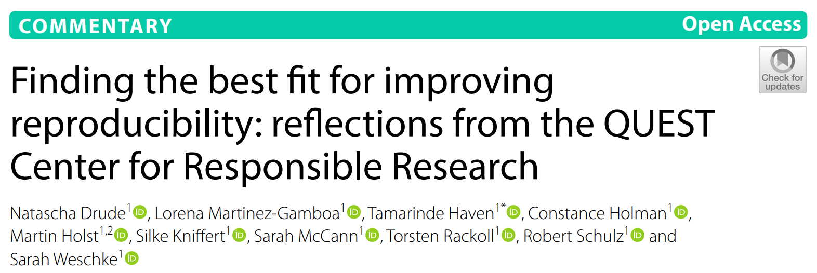
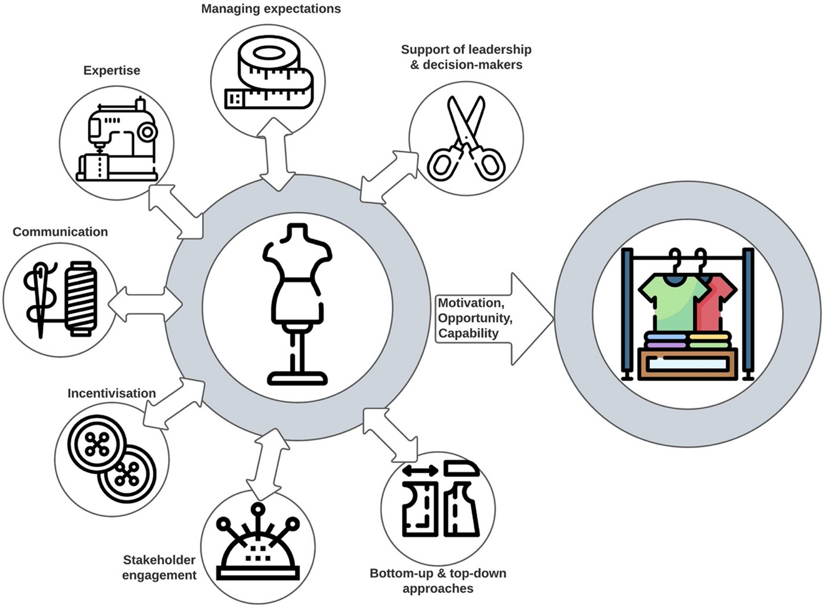
No one-size-fits-all
Broad vs deep interventions

Slide 9

Education/Training as a broad Intervention
Activity
Change Process
Impact
Training
Consulting
Research funding
Tool development
Think tank
Meta research
Patient involvement
Reproducible method protocols, data analysis,…
Access to research data
Responsible research assessment
Black Box
Team Monitoring & Evaluation at BIH QUEST Center for Responsible Research, Contact: christiane.wetzel@bih-charite.de

Slide 10
Training on Responsible Research provided by BIH QUEST Center
Charité/BIH (Berlin Institute of Health)
ELN (Electronic Lab book)
MDC (Max Delbrück Center)
Oxford|Berlin Summer School
BUA (Berlin University Alliance)
Systematic Review
Extern
Reproducible Research with R
Open Data
Fundamentals of Responsible Research
Data Sharing
Research Data Management
Improve Your Science
ReproducibiliTeach
Protocol Development
PSE (Patient & Stakeholder Engagement)
Qualitative Research
Data Re-use
0
200
400
600
800
Participants [Number]
Team Monitoring & Evaluation at BIH QUEST Center for Responsible Research, Contact: christiane.wetzel@bih-charite.de

Slide 11
Theoretical Frame & Methodology (Mixed-Method Research Design)
Quanti → Training transfer survey
adapted from Kauffeld (2008) Sandmeier (2021)
t₁ | Training Design
t₁ | 2-7 d after course completion
t₂ | Learnings & Work Environment
t₂ | 3-4 months later
t₃ | Generalisation & Maintenance
t₃ | 12 months later
Quali → Interviews with participants of Oxford|Berlin Summer School
ECR | Eight interviewees
MCR | Three interviewees
… | 09-11/2021
adapted from Baldwin, T.T & Ford, J.K. (1988)
Team Monitoring & Evaluation at BIH QUEST Center for Responsible Research, Contact: christiane.wetzel@bih-charite.de

Slide 12
Items are answered using a seven-point Likert-type rating scale ranging from strongly disagree (1) to strongly agree (7). Median (magenta), and the range between the 1st and 3rd quartile (grey) are displayed.
Results
t₁: Training design
(n=192/189)
t₂: Learning & Retention
(n=75/68)
t₂: Work environment
(n=71/68)
t₃: Generalisation
(n=33)
Team Monitoring & Evaluation at BIH QUEST Center for Responsible Research, Contact: christiane.wetzel@bih-charite.de
Notes:
Training Design | Example items
Methods (i.e. presentations, exercises) applied in the course helped me better understand the contents of the course.
During the course, I received feedback on my progress
Examples discussed in the course corresponded well to the demands of my research.
Learning & Retention | Example items
What was taught in the course closely matched my job requirements.
After the course, I know substantially more about the course contents than before.
My participation in the course is / was very useful for my job.
Work Environment | Example items
→ please note: Transfer Support refers to supervisor support, Transfer Climate refers to team support
I do have all resources available that I need to implement what I have learned in the course.
My supervisor motivates me to put the knowledge acquired in the course into practice.
My colleagues appreciate me utilising the knowledge I learned in the course.
Generalisation | Example items
I encounter situations in my everyday work practice where I can apply knowledge acquired in the course.
Overall, I have the impression that through the application of course contents, the working atmosphere in my team has improved.

Slide 13
Interview quote
getting support
“When I came back, […] my professor was really happy I joined the [QUEST training]. And I asked for funding from the hospital, and everyone was quite happy. My professor said, 'Okay. So when you come back, you have to teach us all these things.'”
T-Transfer_INT-TK_02
Team Monitoring & Evaluation at BIH QUEST Center for Responsible Research, Contact: christiane.wetzel@bih-charite.de

Slide 14
Interview quote
No support – no discouragement
“[…] I have to also say, that he/she [supervisor] is not discouraging me from doing it. He/she is also not really supportive. It is like: ‘Yes, do whatever you want.‘ I can tell you an anecdote: When I started my PhD, I told him/her I'll do my experiments in a blinded fashion, it is important. And he/she was half-jokingly answering: ‚Yeah, okay, sure, do it. If you don't want to get publishable results, it is your way'. And I think, I mean, he/she is not 100 percent serious with that, but I think it is still showing, how he/she thinks about it.”
T-Transfer_INT-TK_04
Team Monitoring & Evaluation at BIH QUEST Center for Responsible Research, Contact: christiane.wetzel@bih-charite.de

Slide 15
Interview quote
Discouragement
“Often it goes like this that a call appears, there is time pressure. A large team of different partners comes together. Some of them have never heard of this [OS and RRI]. There are hierarchies. Especially not being a professor I have to speak against everyone. And there are people who turn their eyes because they may be more advanced in their career and don’t want to be told that things could be done differently. And somehow it gets lost in the sense of ‘choose your battles’ because at some point I think: ‘Well, oh my God okay, then we do it the way you want, the proposal is not going to get approved anyways.’ And suddenly the proposal does get approved and I’m in the project.”
T-Transfer_INT-TK_06, free translation
Team Monitoring & Evaluation at BIH QUEST Center for Responsible Research, Contact: christiane.wetzel@bih-charite.de

Slide 16
Results
With regard to OS & RRI adoption, the Work Environment is a key factor that needs to be understood in its complexity.
Perceptions of power, influence, and roles in organizational change processes related to OS & RRI differ between Early Career Researchers (ECR) and Mid Career Researchers (MCR).
MCRs may not see themselves as advocates for change towards their colleagues but rather hope for the younger generation to lead systematic change.
ECRs, however, point out that leadership by more senior researchers is crucial, as supervisors can either actively support or prevent the adoption of OS and RRI.
The results highlight the need to create awareness of the social mechanisms of OS and RRI adoption.
Team Monitoring & Evaluation at BIH QUEST Center for Responsible Research, Contact: christiane.wetzel@bih-charite.de

Slide 17
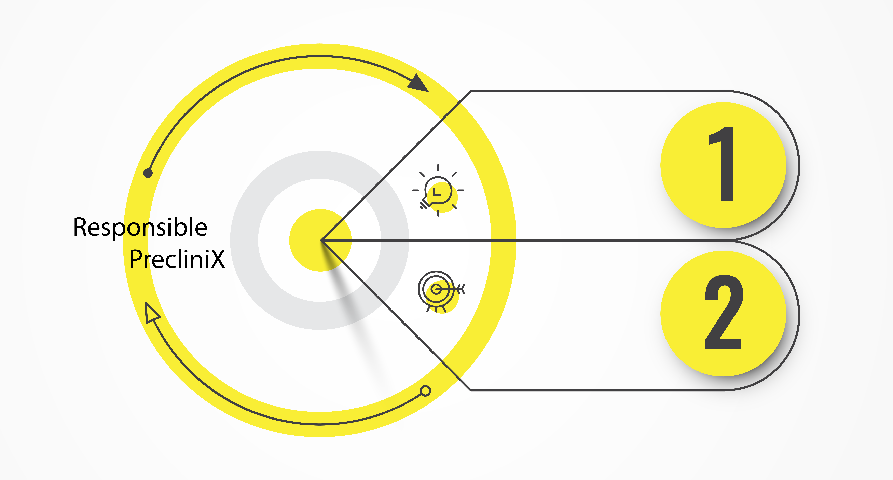
Responsible PrecliniX (RPX) to overcome challenges in translational biomedicine (deep intervention)
Meta-Research on Translation as a Science
Project Specific Consulting for Robust and Reproducible Research

Slide 18
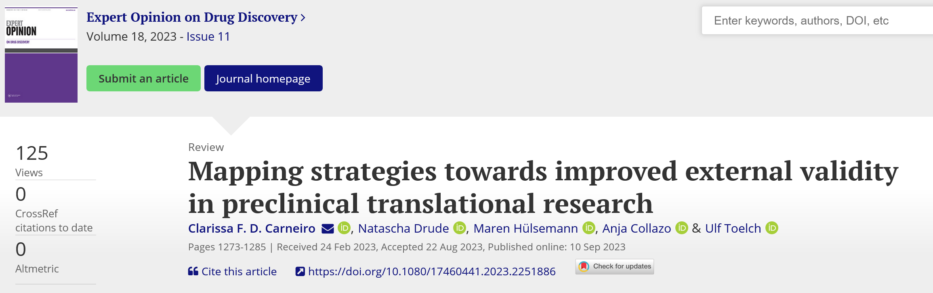
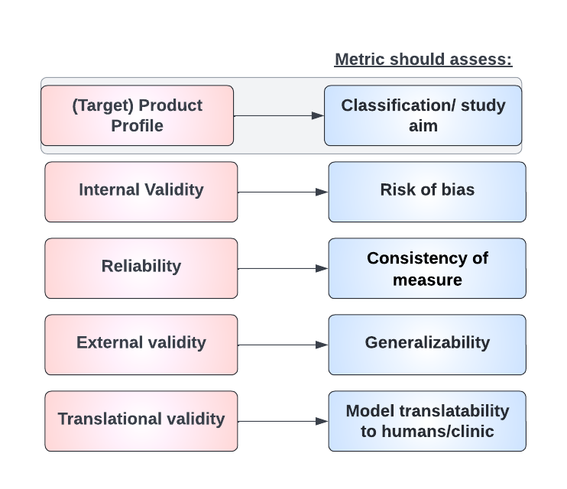
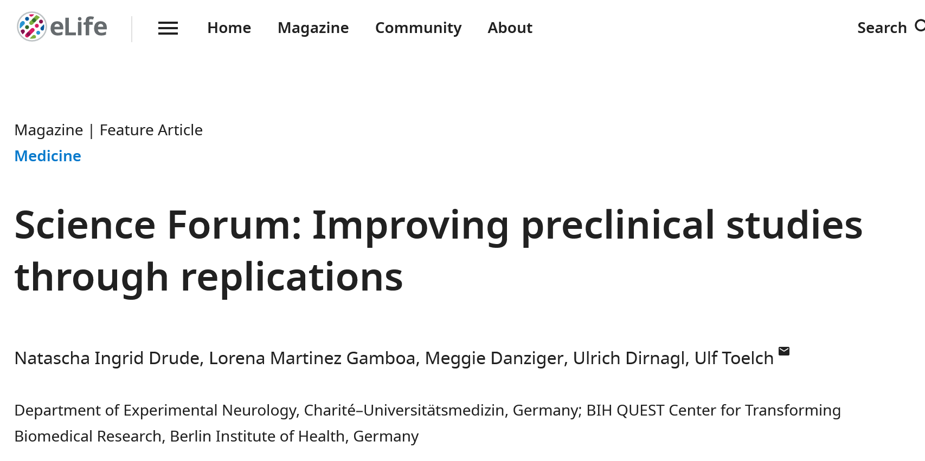
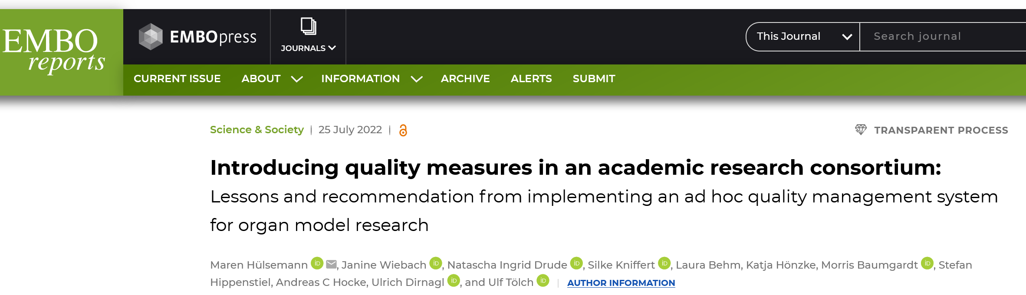
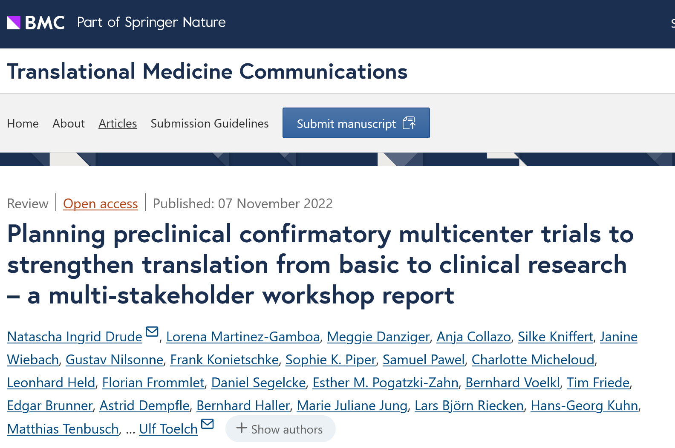
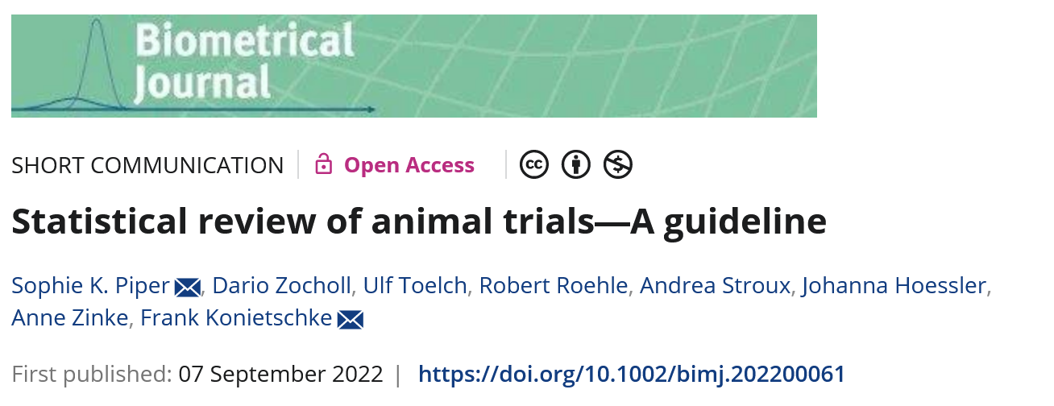
Meta research informed consulting framework
47 items (9.4 ± 2.4 questions per category)
Scoping review + workshops + needs assessment
Notes:
Based on Guidelines (like ARRIVE), systematic reviews, lack of reporting, conceptual paper, ….

Slide 19
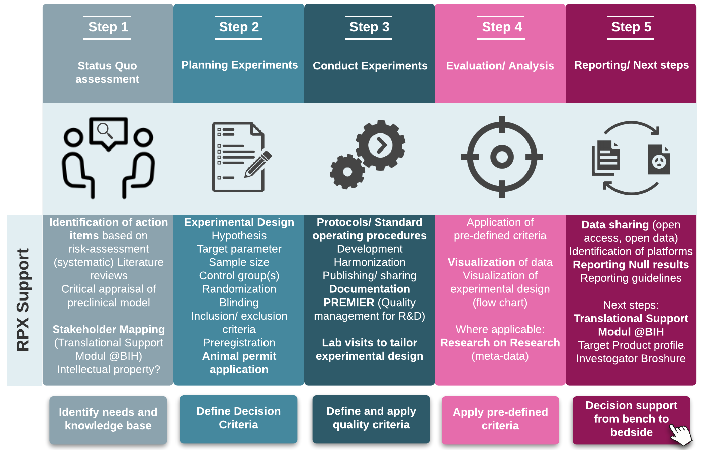
Holistic approach towards evidence syntheses
Notes:
If uncertainty is still high, optimization of evidence via replication studies to (i) increase sample size, (ii) improve internal validity, (iii) introduce systematic heterogenization and/or (iv) flanking experiments
Internal validity, reliability and external validity
Nicht die einzelne Publikation
Holistischer Ansatz
Evidenz-synthese

Slide 20
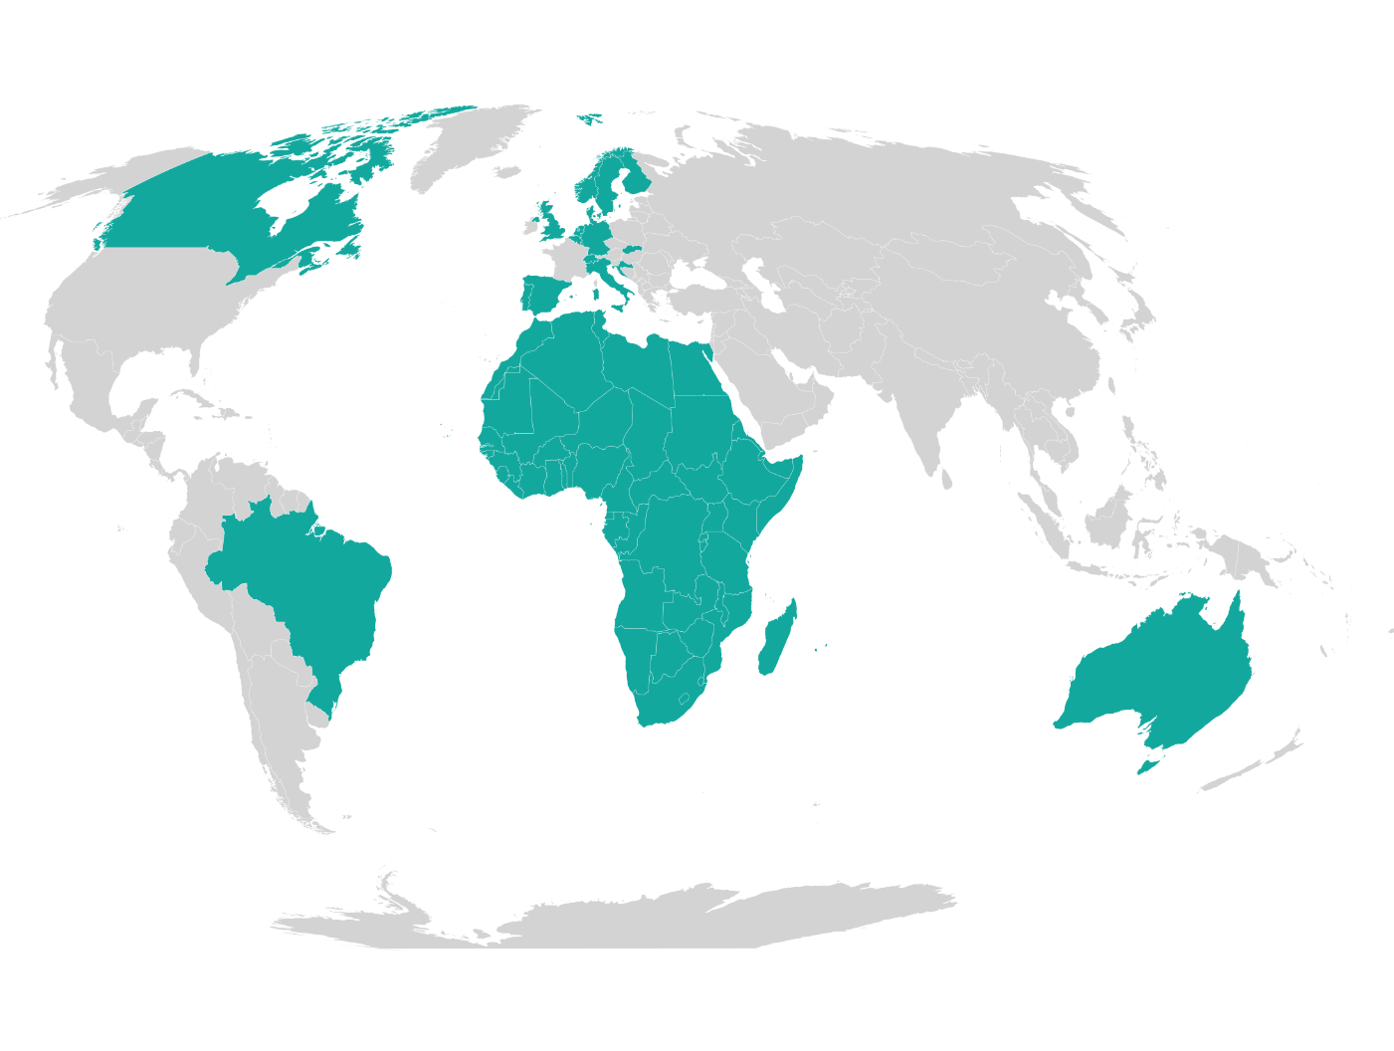
Reproducibility Network
Communities
https://osf.io/aq5je
A strategy for a loose
federation

Slide 21
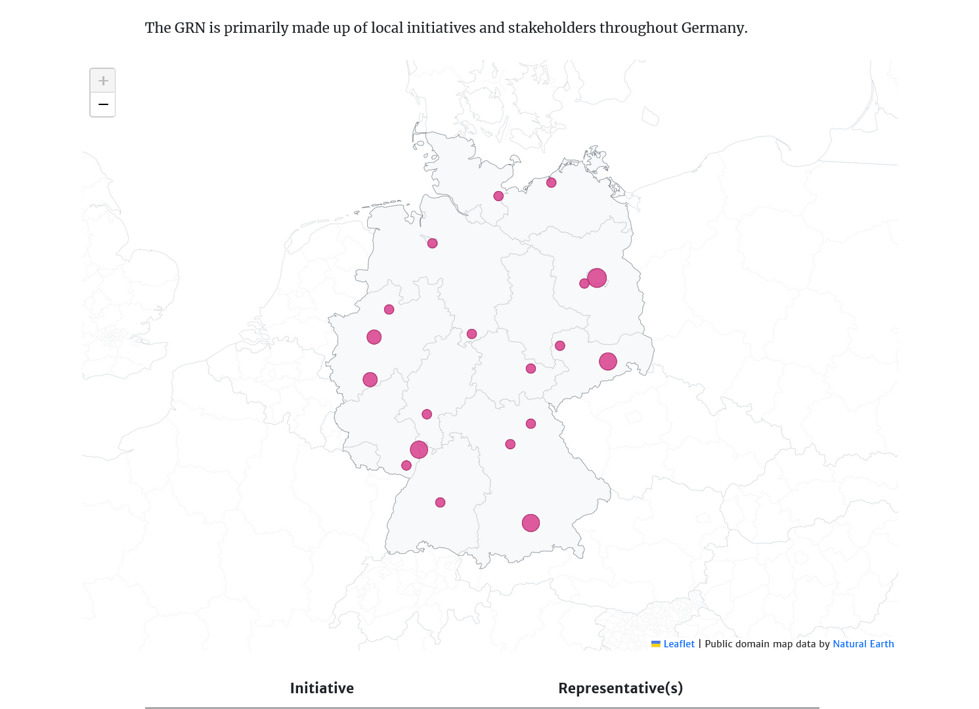
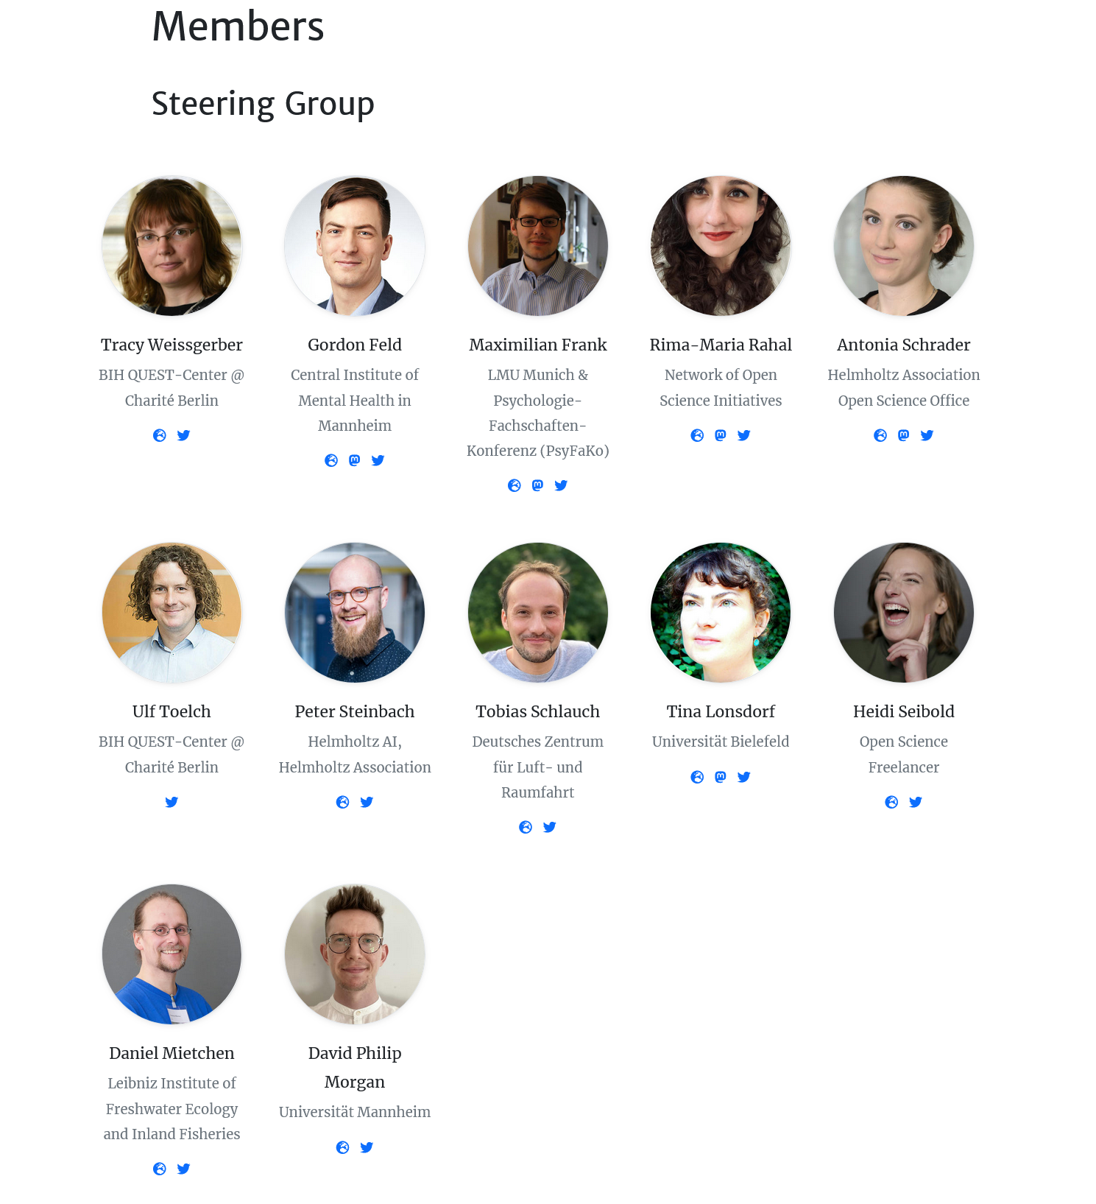
The German
Reproducibility Network

Slide 22
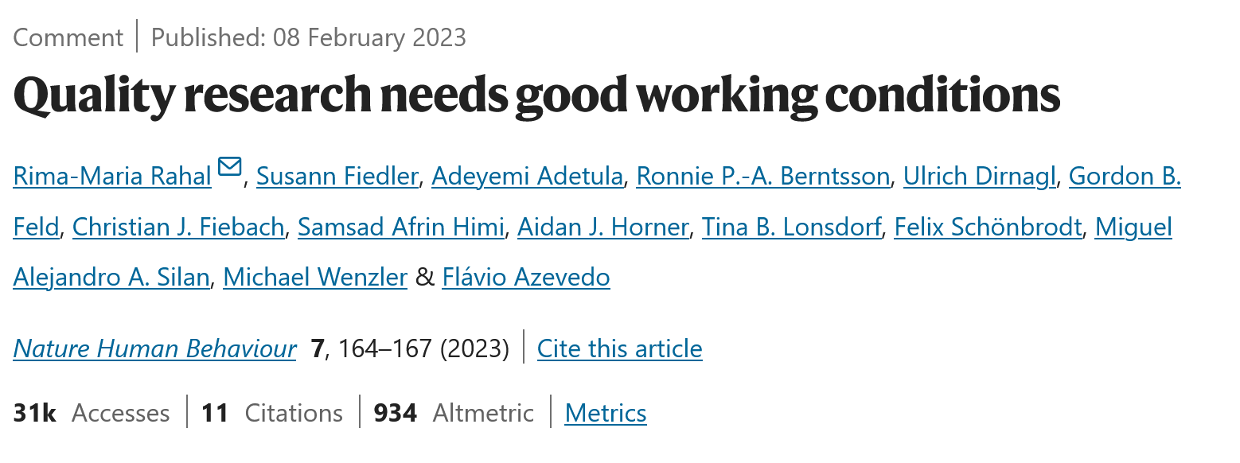
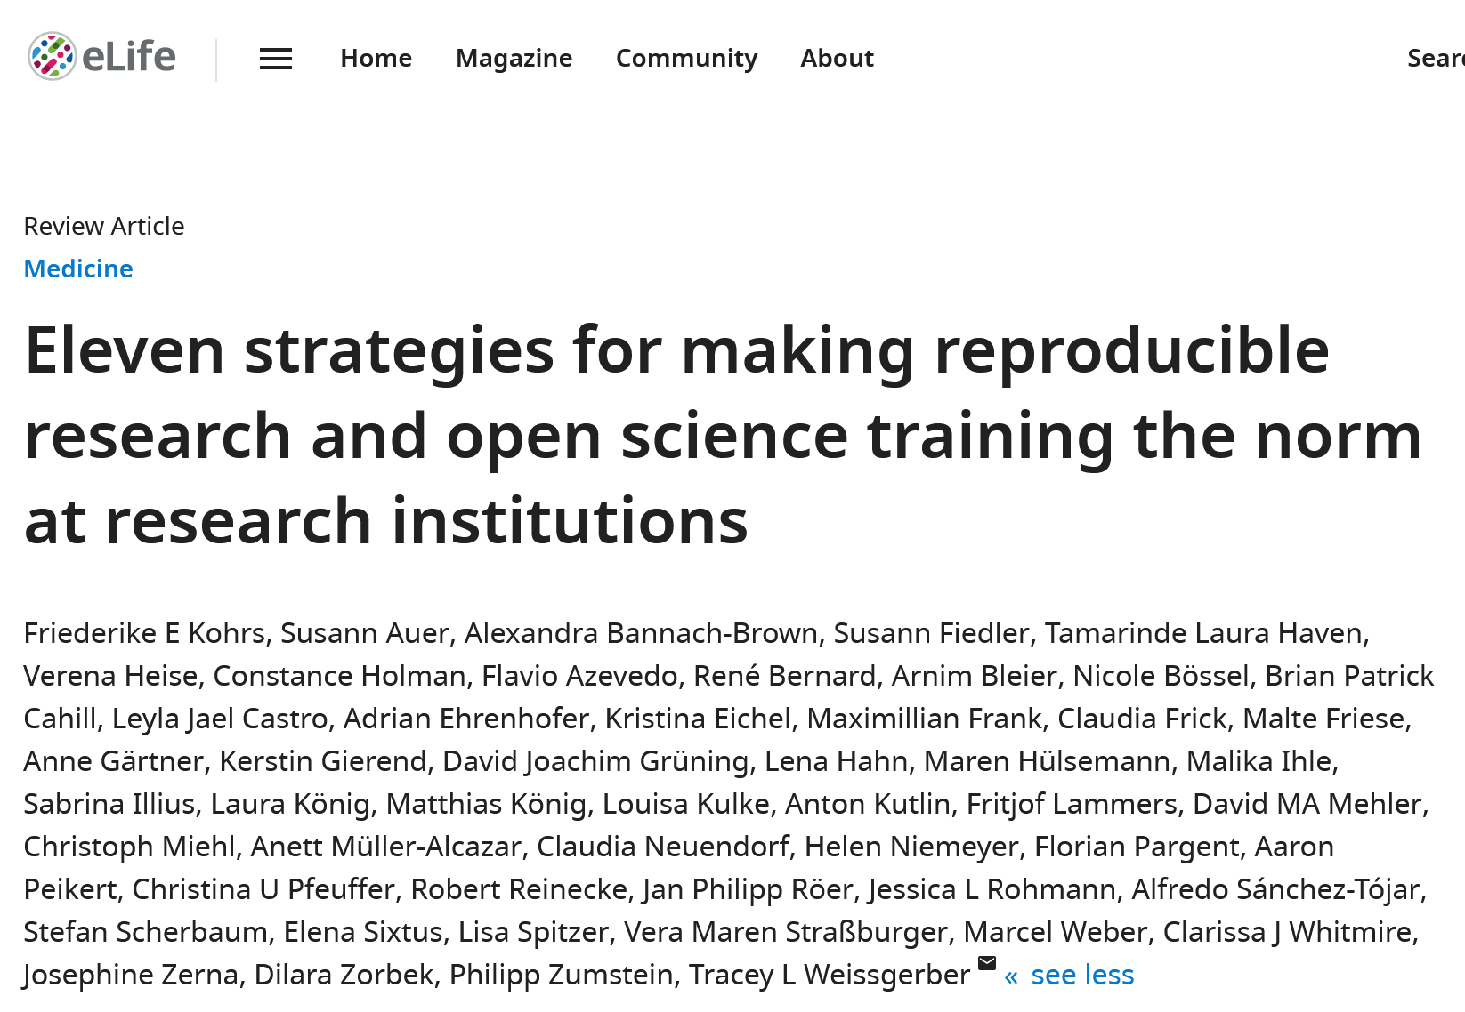
GRN Outreach Activities
Joint Publications
Virtual Brainstorms
Summerschools
Berlin|Oxford Summer School on Responsible Research
Meta-Science Summer School: Designing Studies to Improve Research

Slide 23
GRN Challenges
Currently no funding; all volunteer work
Community outreach difficult and time consuming
What added value does an RN have?
Sometimes more governance body than action entity

Slide 24



Three reproducibility projects funded by the EU
https://tier2-project.eu/
https://osf.io/k2nzv
The futures of reproducibility
https://www.irise-project.eu/
https://osiris4r.eu/

Slide 25
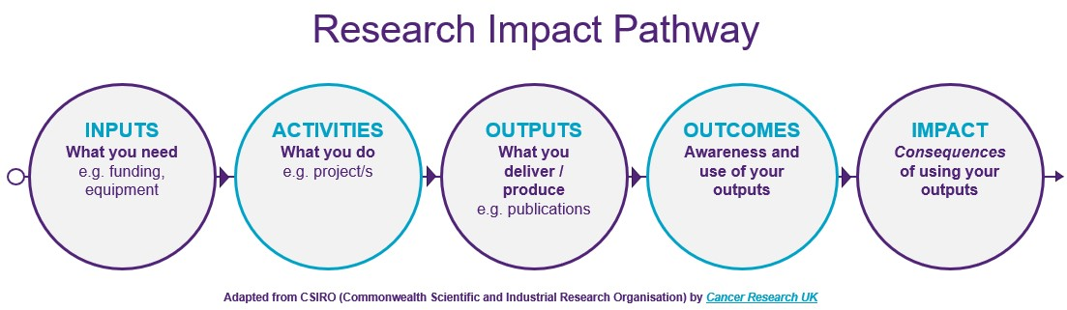
Measuring impact

Slide 26
Measuring indicators of robust research
Developed together with Tim Errington, Brian Nosek, Tamarinde Haven, Clarissa Carneiro

Slide 27
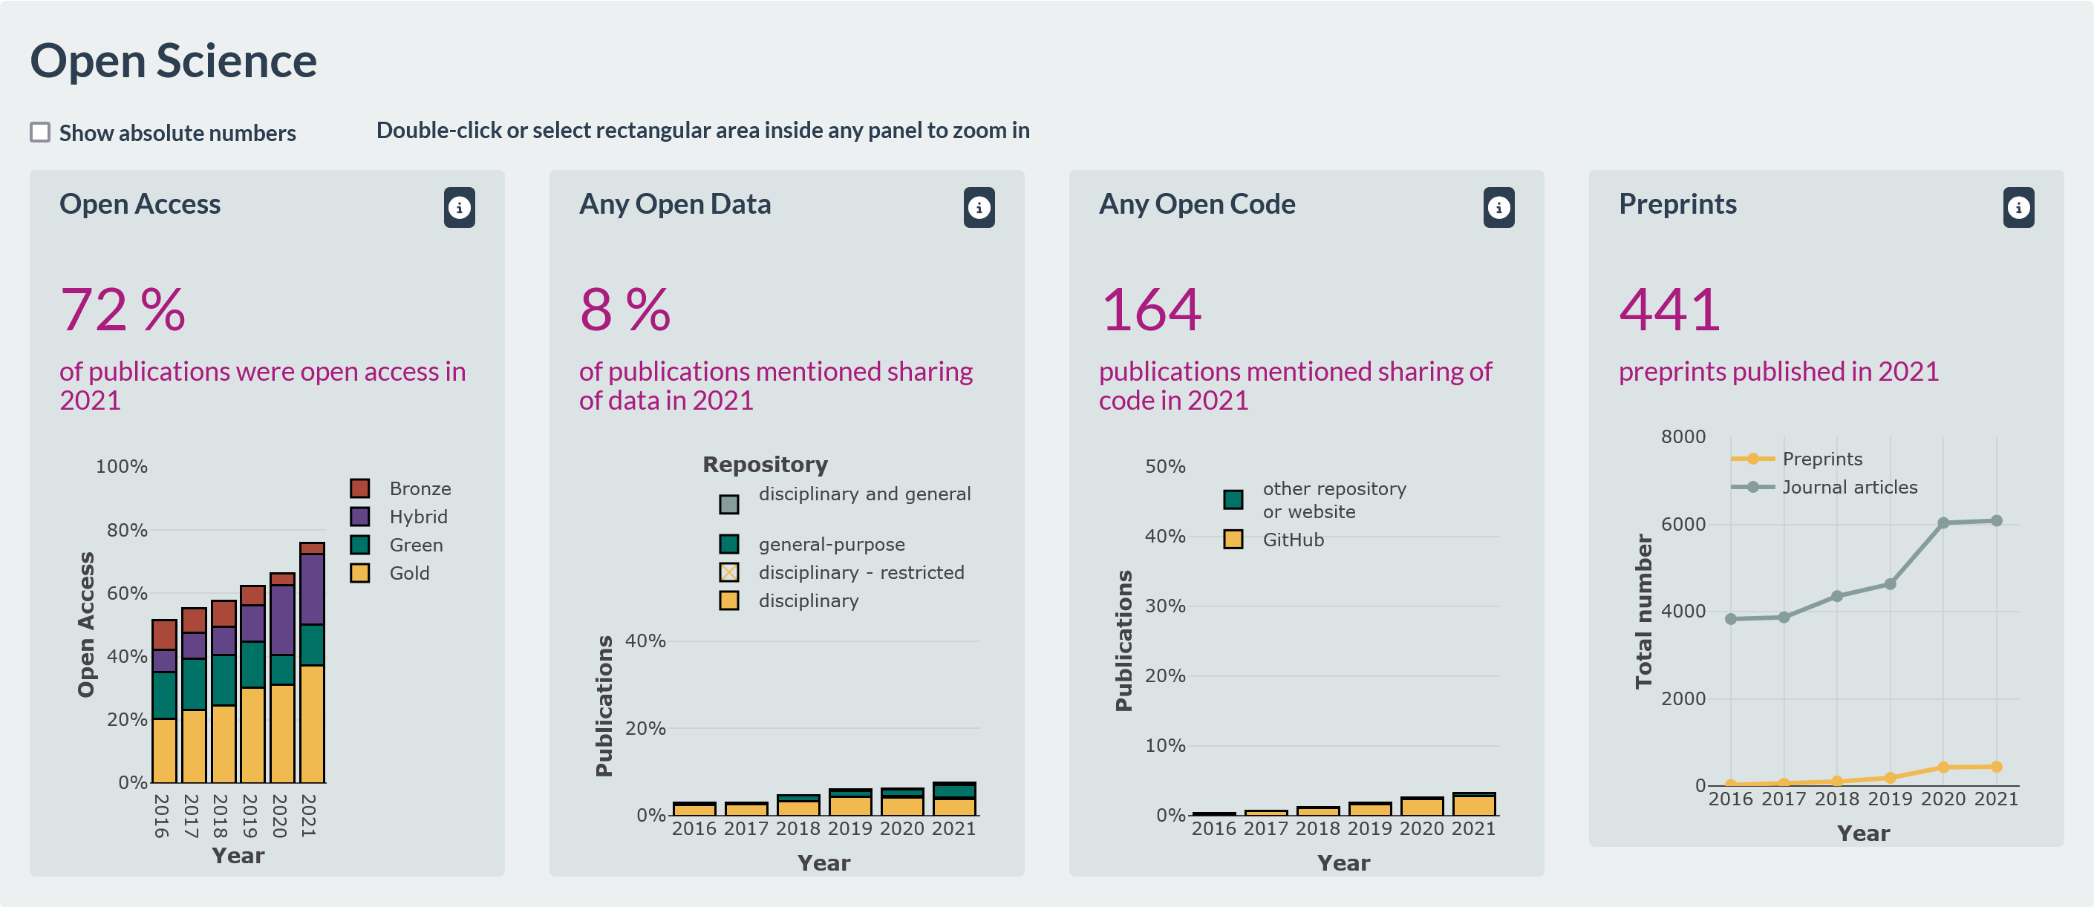
Make it measurable
https://quest-dashboard.charite.de/

Slide 28
Joint activity on international level
Currently: Berlin|Oxford Summer School on open and responsible research (60 international participants). Registration for 8th Summer School 2024 opens on 1st of April
Goal 2025: Reproducibility Week with Summer School as central hub.
All RNs are asked to contribute with local initiatives; lectures from summer school will be streamed in the morning; WS will be conducted locally or online
Joint program of all RNs
Some funding from QUEST and Oxford available for summer school
Does not necessarily need to be conducted in Berlin|Oxford

Slide 29
Summary
To make reproducible research the norm:
Diverse set of low entry interventions needed (broad vs deep)
Barriers (e.g. work environemnt= need to be identified and mitigation strategies are needed
Reproducibility networks need to be strengthened on national and international levels
Outcomes and impact need to be measurable

Slide 30
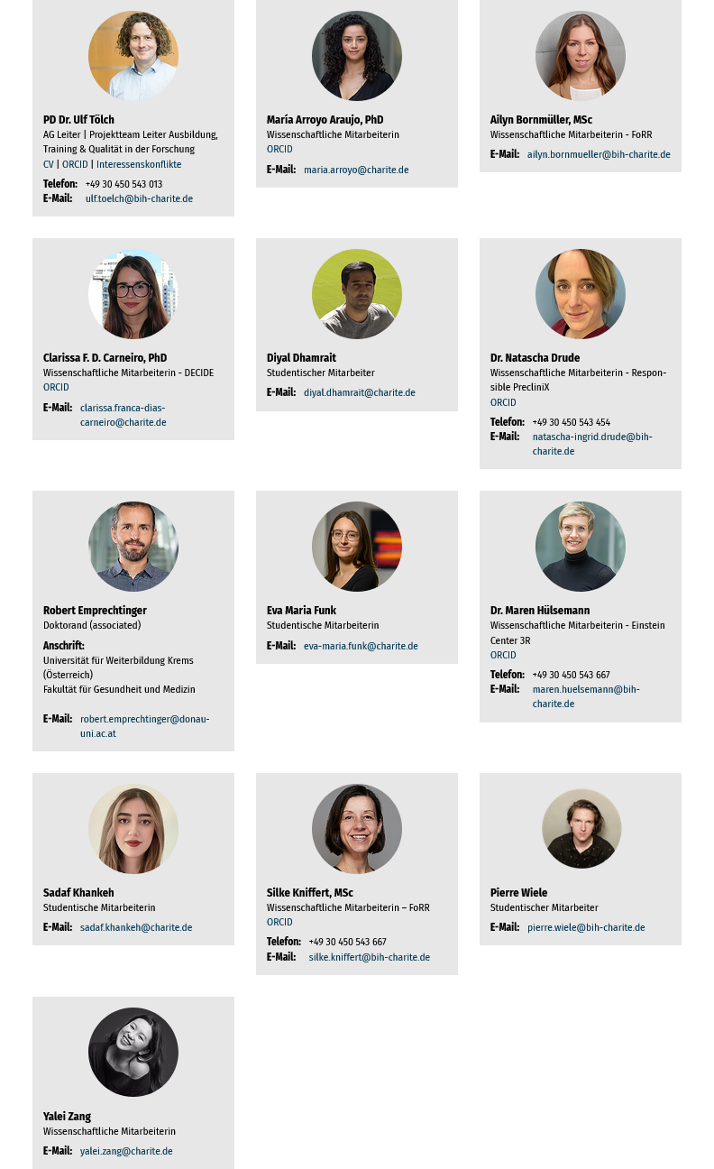
Thanks to the team.
QUESTions?

